Slide 1

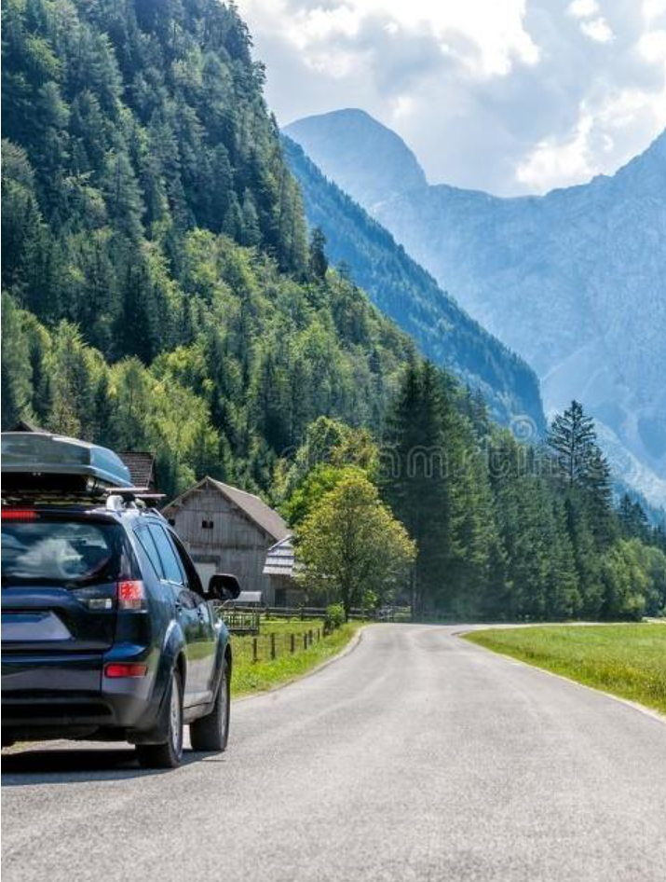
Web
Presentation
CAMPUS
Team member name
Tian Chenmeng/ Fei Mingyue/ Wang Jia/ Qi Danyu

Slide 2
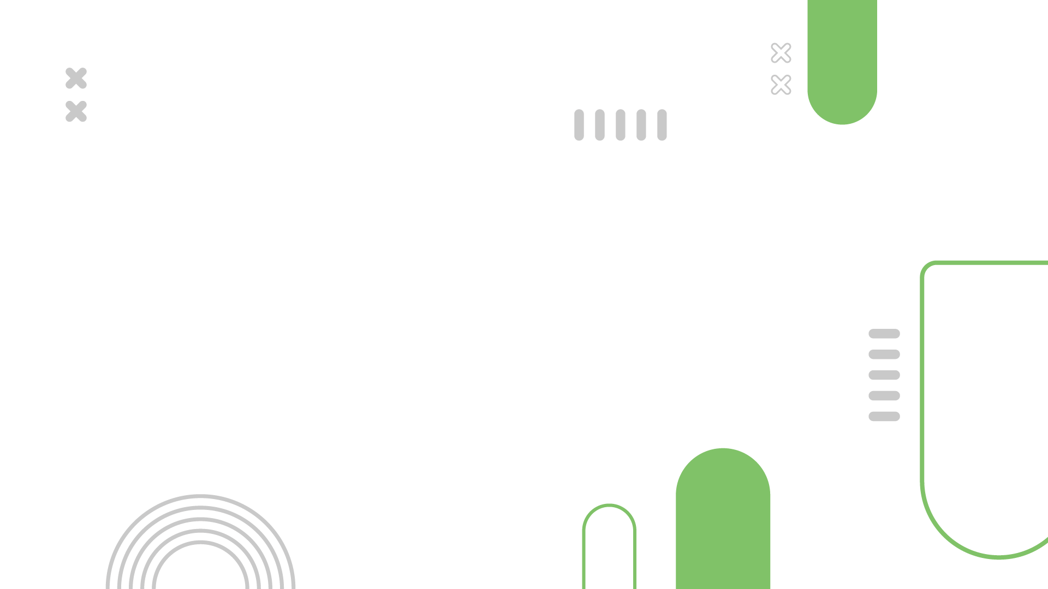
CONTENTS
01
Theme Introduction
02
Design Concept and Analysis
03
Function Display
04
Collaboration Summary

Slide 3
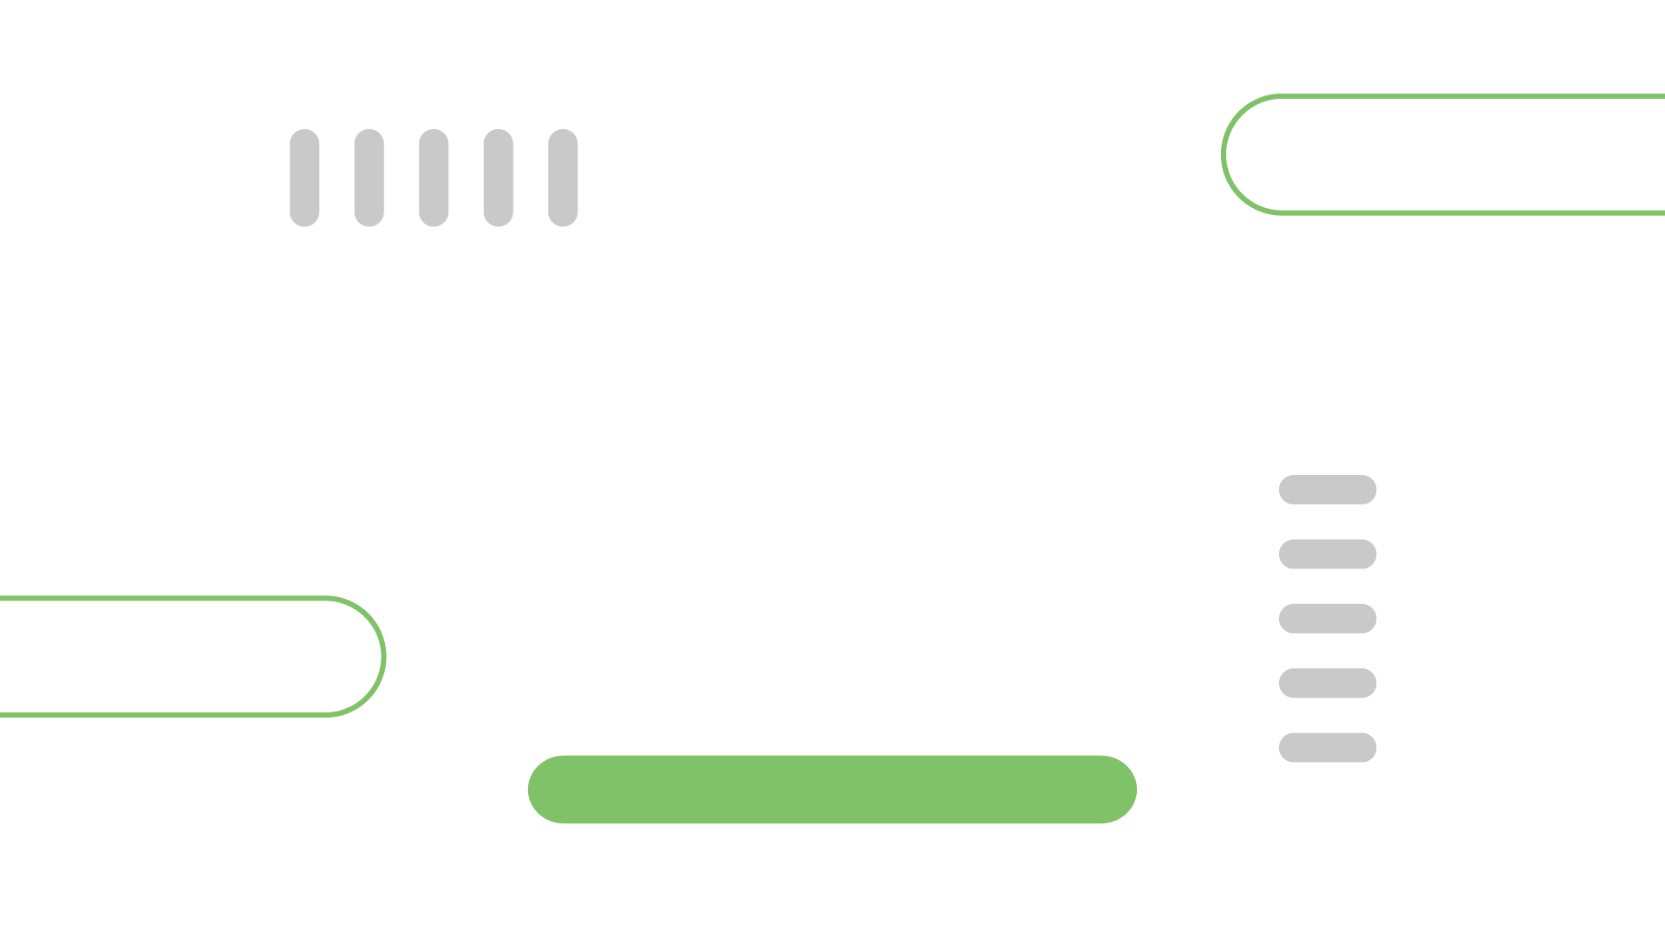
01
Theme Introduction

Slide 4
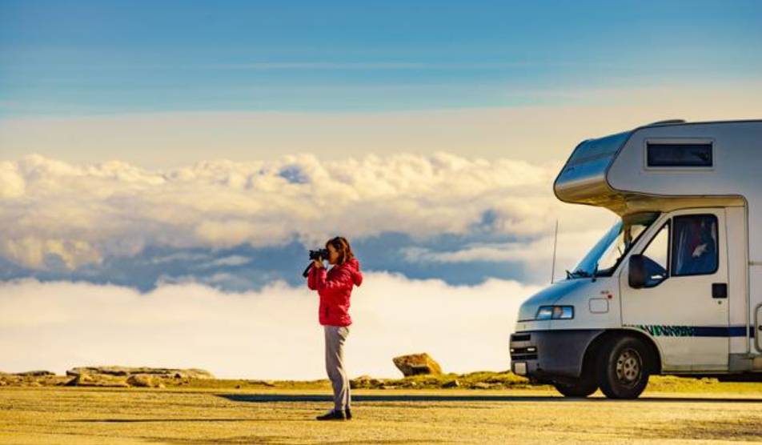
Theme Introduction
Shared Journey
Travel
A social networking site for carpooling during travel, providing a convenient negotiation platform for passengers with a common starting city and destination, allowing several people to rent vehicles together for travel.
carpooling
socialize
Shared Rental
Community posts

Slide 5
02
Design Concept and Analysis

Slide 6
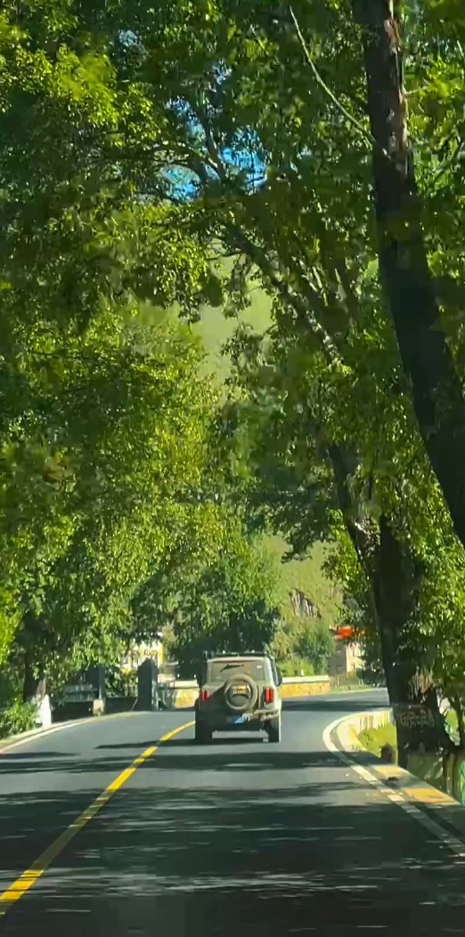
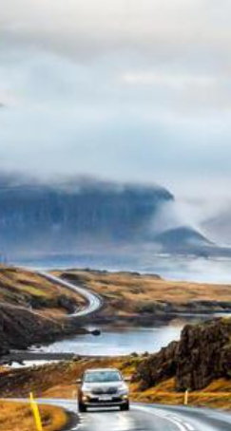
Design Concept and Analysis
Safety
Safety is the most important, and customers hope to ensure their safety when using taxi services.
Accompanying
Carpooling has a social dimension, where users crave to quickly find companions.
Administration
The uncertainty of routes and the possibility of artificially inflated prices are a concern for users.

Slide 7
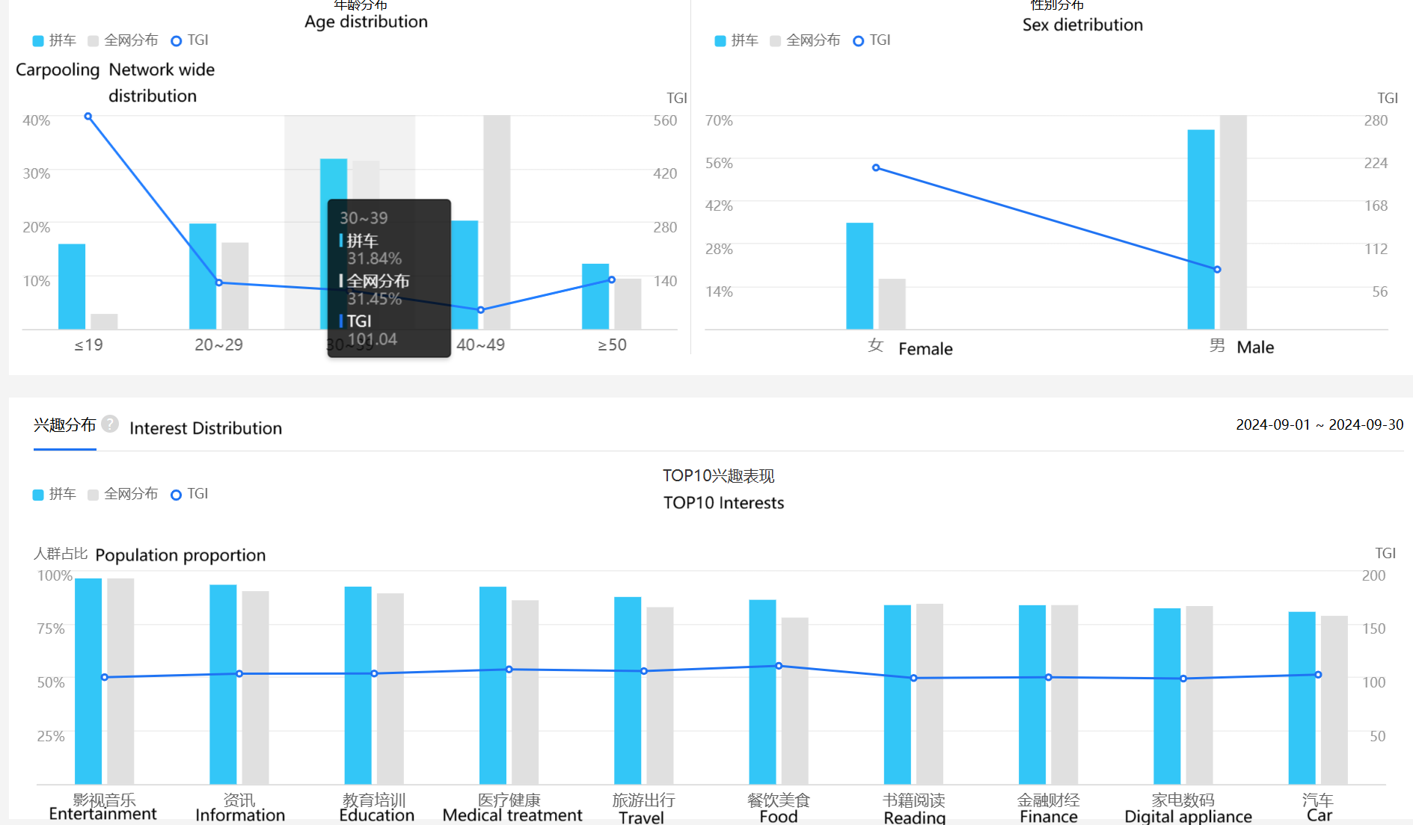
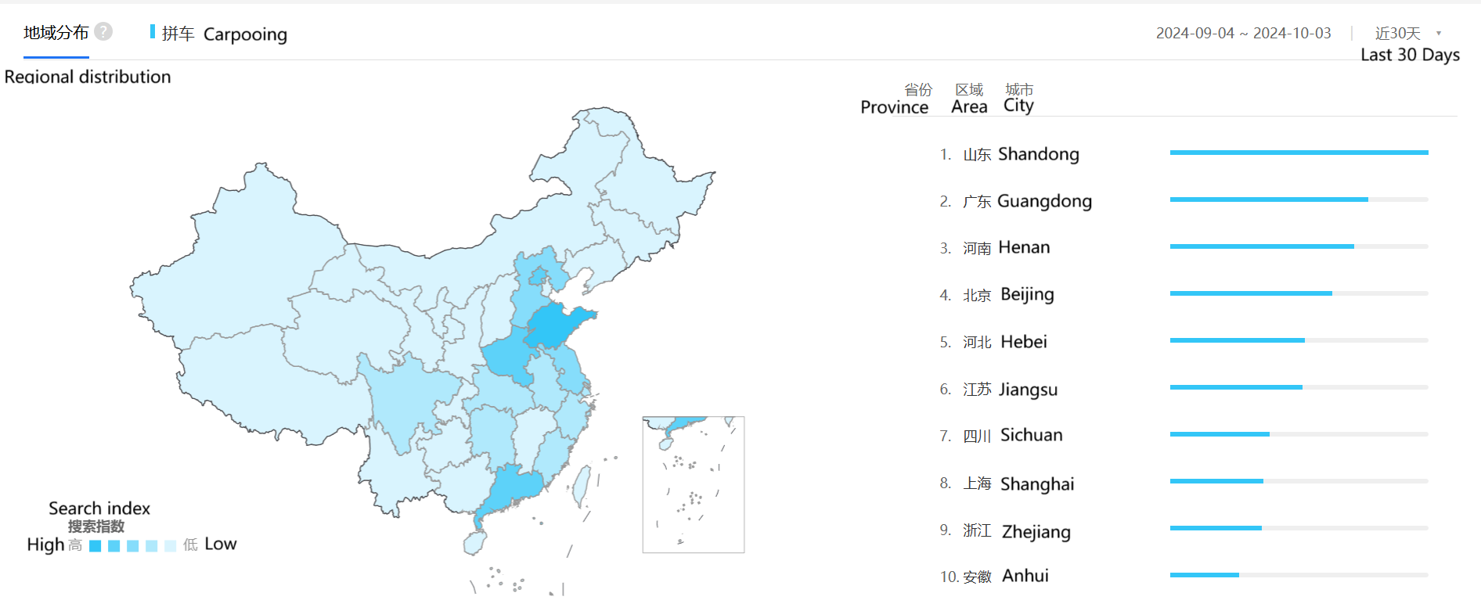
Design Concept and Analysis
Market analysis
In our analysis of the target user group, we found that the users of carpooling services are mainly located in first - and second tier cities. Most of these people belong to the 1980s and 1990s, with males accounting for nearly 70% and females accounting for about 35%. Their monthly income is usually less than 15000 yuan, and they value efficiency, cost savings, and sustainability. Their characteristics include a strong tendency to embrace new trends and strict demands for higher quality of life. In addition, they have shown a high level of interest in movies and entertainment.

Slide 8
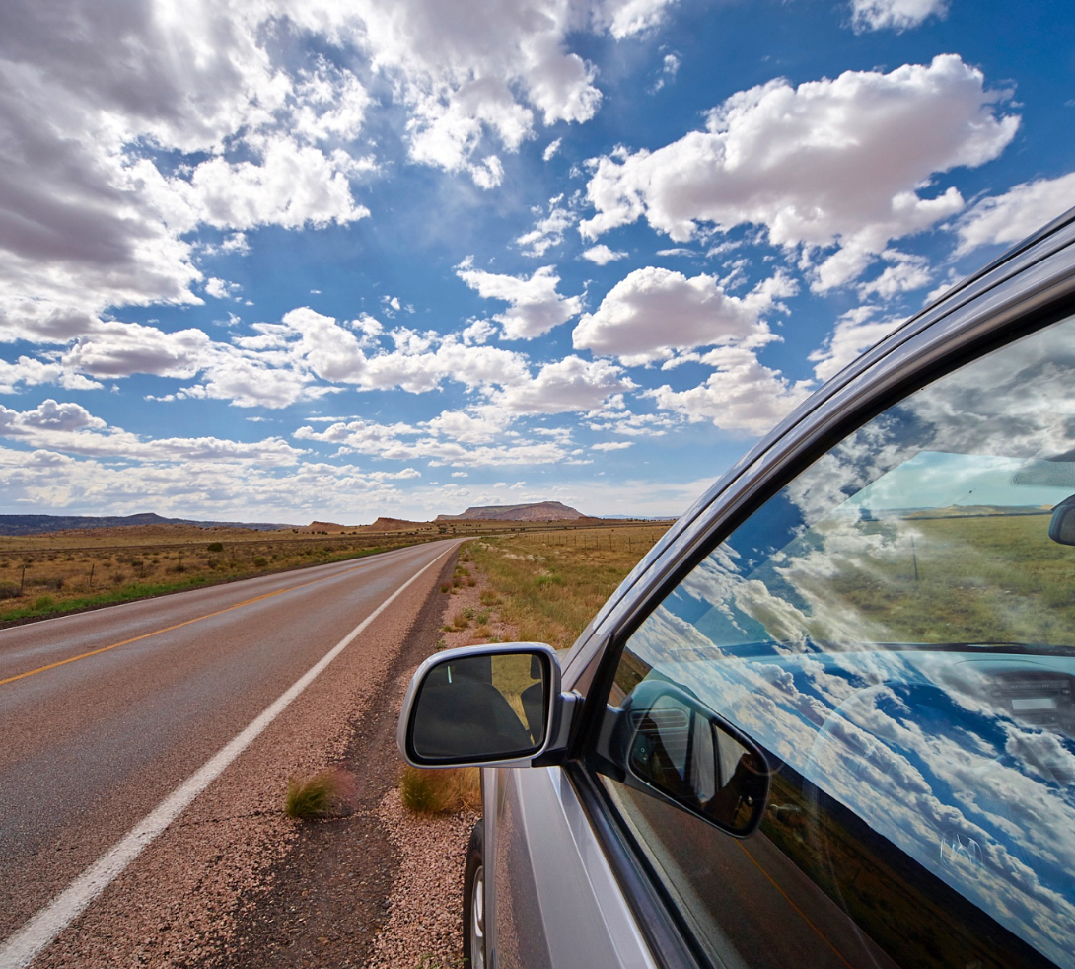
Design Concept and Analysis
Passenger communication
Community
Recruit a team of passengers who have already decided on their destination.
Build a social platform where users can post invitations and suggestions.
Map positioning
Ride-Hailing
Directly specifying the starting and ending points facilitates filtering vehicles and matching drivers.
Quickly determine the route mileage with the help of satellite map positioning.
Suggested itinerary
Travel recommendations
Provide selectable travel destinations for users who have not yet made a decision.
Recommend suitable tourist destinations in real-time based on time and location, including cities, features, transportation, hotels, etc.
项目名
Target/Partition

Slide 9
Design Concept and Analysis
Color scheme
Conception
User experience
Color allocation
Combination
The color design of the webpage is simple and elegant, with green as the main color, including dark olive green and front olive green, supplemented by gray.
The green color scheme, as the main color tone, can intuitively convey the concept of respecting and protecting the natural environment, and it perfectly matches the green travel theme promoted on the website.
Green has a natural calming effect and can provide people with a peaceful and comfortable visual experience. Enhance users' expectations and interest in tourism activities.
Green is used to highlight key elements in web pages, such as registration buttons, itinerary bookings, etc. Light gray, as a neutral color, serves as a background to make the content more eye-catching.
The combination of green and light gray can convey a warm and welcoming feeling, allowing users to experience a relaxed and trusting atmosphere.

Slide 10
Design Concept and Analysis
Page format and font selection
The title uses Playball and has an elegant letter style. The first and second level titles are 50px and 40px respectively. The main content and footer use default fonts, with a simple design that improves page loading speed. The block reference and font within the block are Alkatra, conveying a free personality, with a font size of 30px. All font thickness is set by default, resulting in a more natural visual effect.
Percentage and relative units are often used in layout to define the width and layout of elements, allowing the page to dynamically adjust with changes in the browser window. The page does not use a fixed pixel width to limit the width of containers or elements, and maintains fluidity and adaptability. We used CSS grid layout (grid template columns: 2fr 1fr) to ensure that the content displays well on different devices. The images and content blocks use relative units and auto resizing, and page design relies on relative units and adaptive layout, which allows content to automatically adjust according to container size and adapt to devices of different sizes. Each area is dynamically arranged through CSS Grid to ensure that the size and layout of the area are dynamically adjusted according to the screen width.

Slide 11
03
Function Display

Slide 12
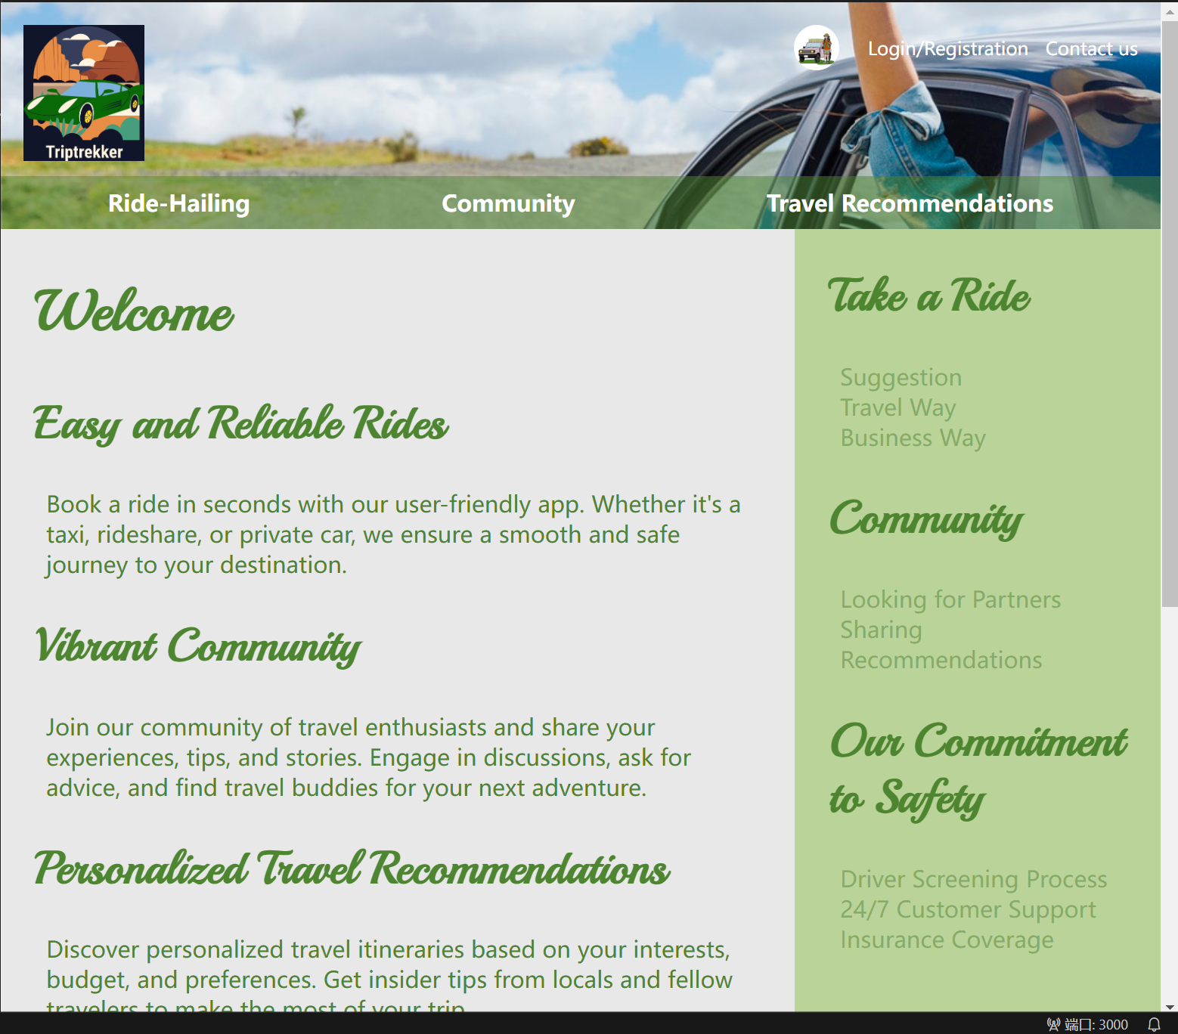
Function Display
Header
The included links lead to three main modules - Ride Hailing, Community, and Travel Recommendations, which can be accessed by clicking on different corresponding pages.
Website Introduction
A brief description of the theme style and customer-oriented service content of the webpage was provided, and the division and functions of the three communities were sorted out, serving as an illustration.
Suggestions and services
Linking cycling and community, providing effective suggestions for reference, deepening users' understanding of website applications, and enhancing user experience.

Slide 13
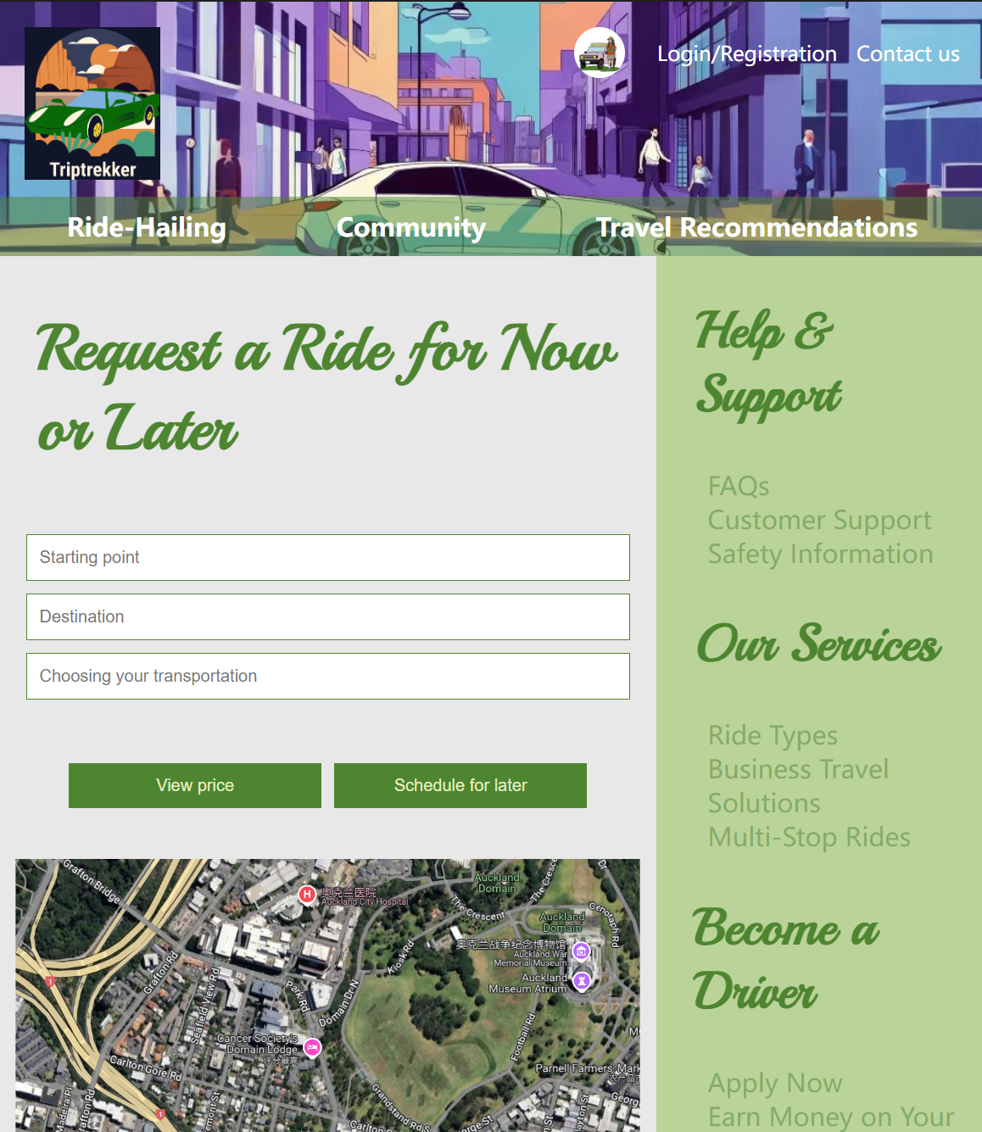
Function Display
Options
Title: Inform users of the main interface functions.
Input window: Enter the user's starting point and target endpoint, as well as the desired matching transportation, such as buses, taxis, express trains, etc., and filter suitable routes and drivers based on this information.
Button: After determining the route, check the corresponding price and mileage. The corresponding time schedule includes start and end dates as well as the driver's arrival time
Side border
Auxiliary function: Provide users with clarification and necessary assistance. It includes search guidance related to webpage information, discount modes related to travel, and announcements about becoming a merchant driver.

Slide 14
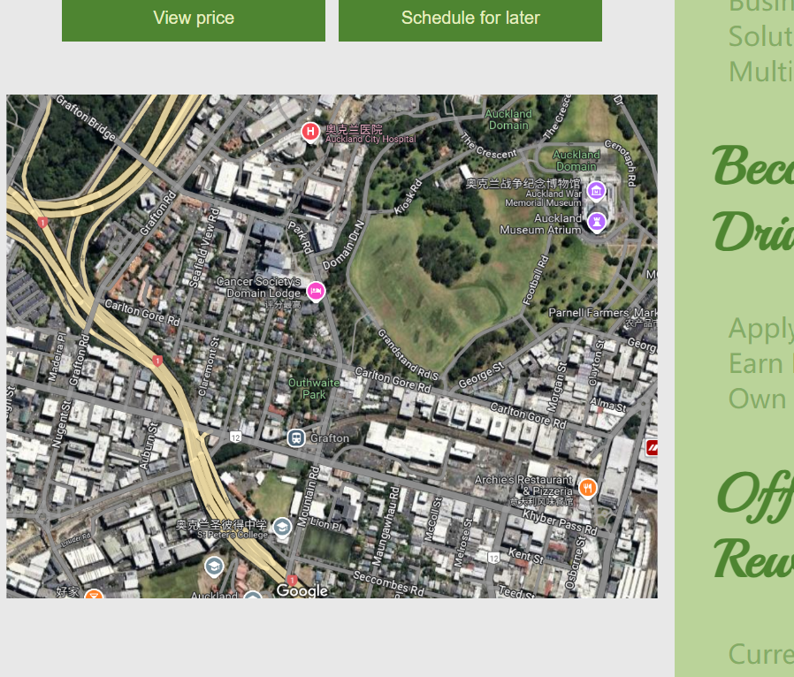
Function Display
Satellite map
Used for intuitive positioning and display of planned routes.

Slide 15
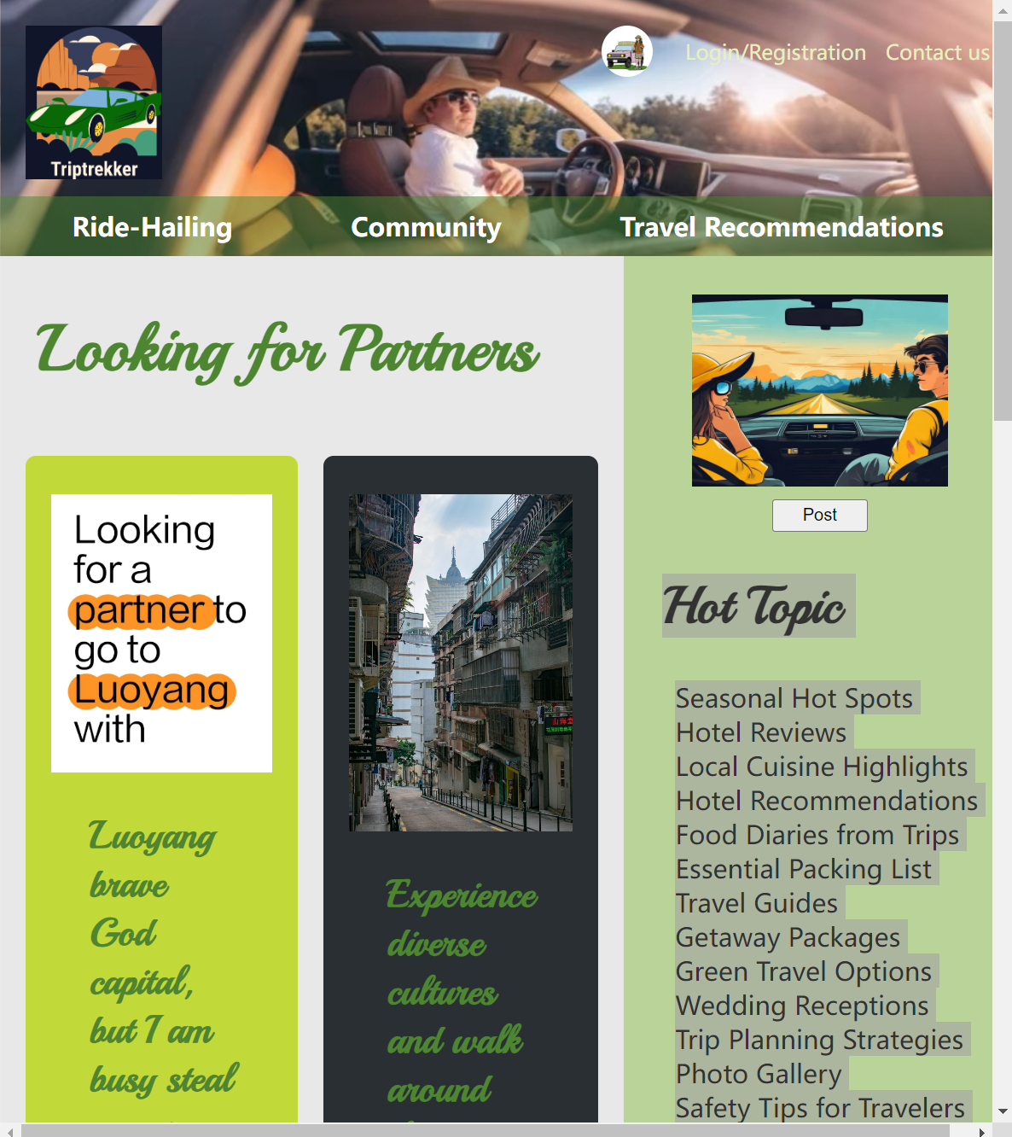
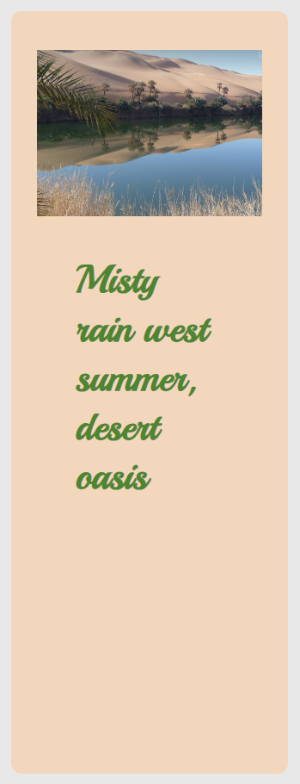
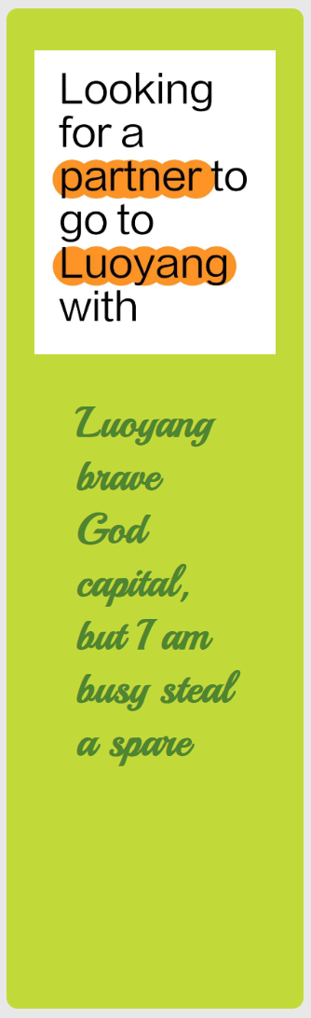
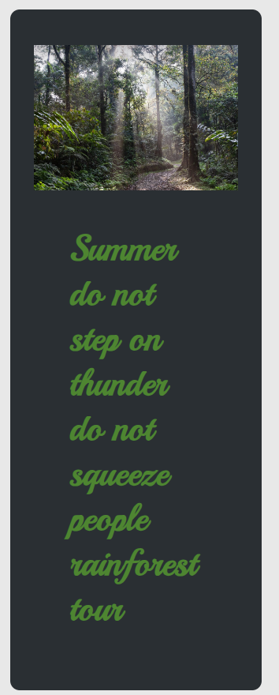
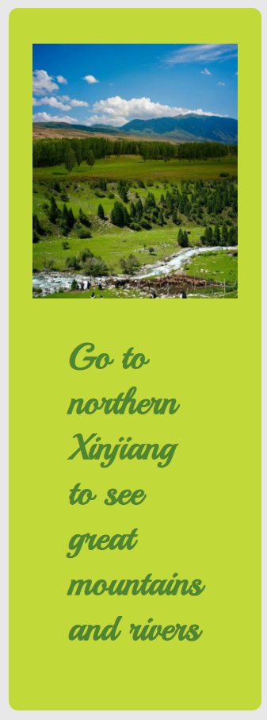
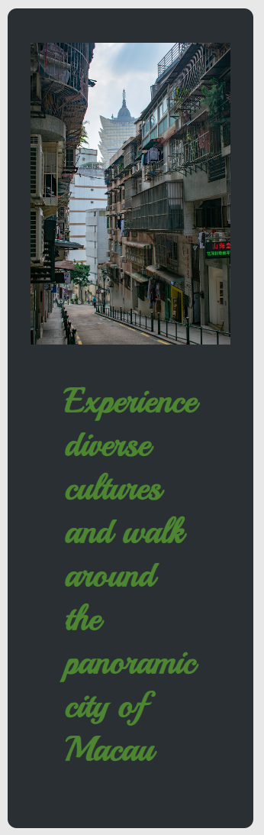
Function Display
Community motherboard block
Users can find various posts seeking carpooling and introductions to travel destinations here, as well as post and share personal plans. If people become interested in this after browsing, they can contact and form a team through the interface.
Recommended page bar
Here, topics related to the post will be presented, filtered by demand and discussion level, and options will be listed. You can directly enter the corresponding category of posts by clicking on the link.

Slide 16
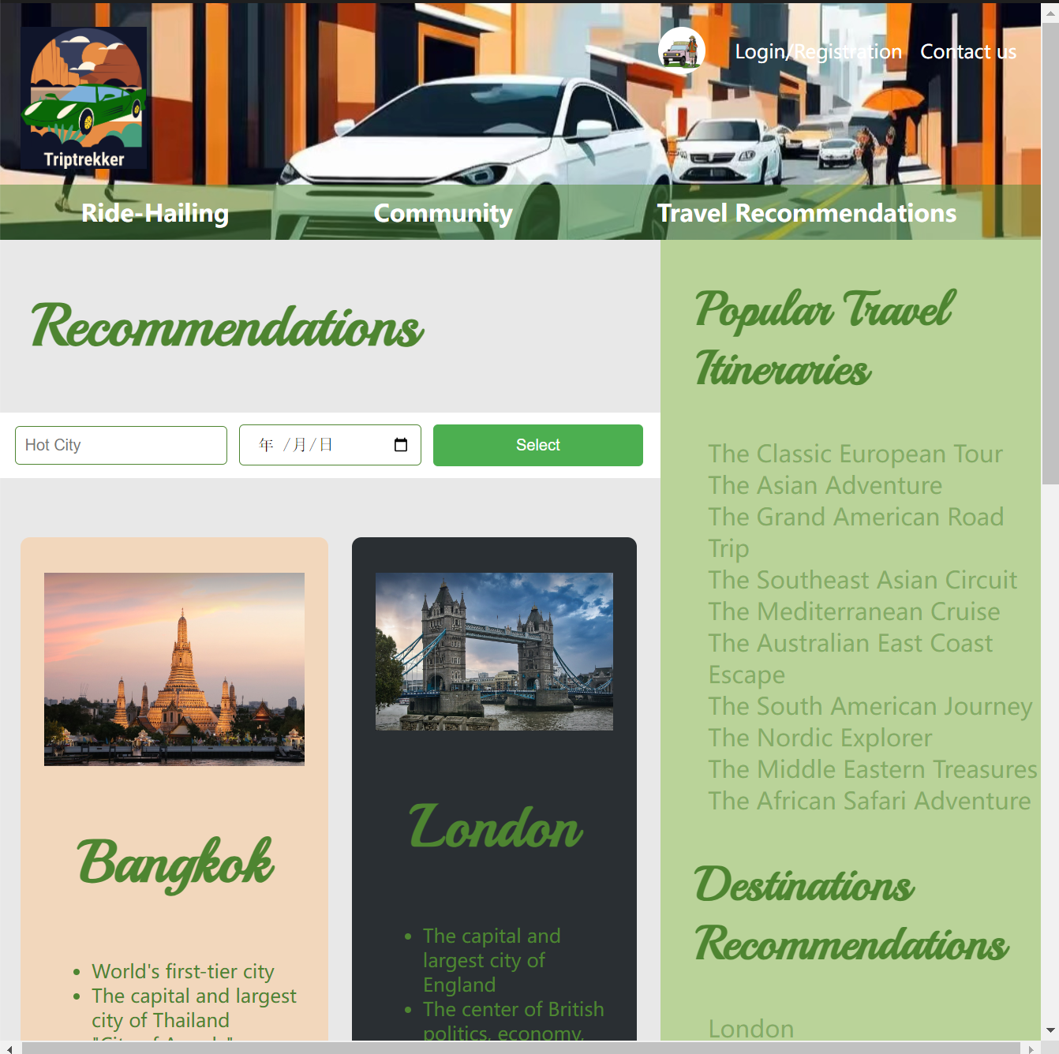
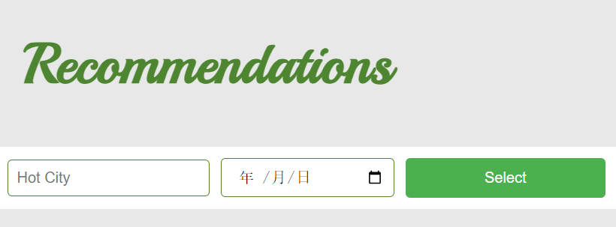
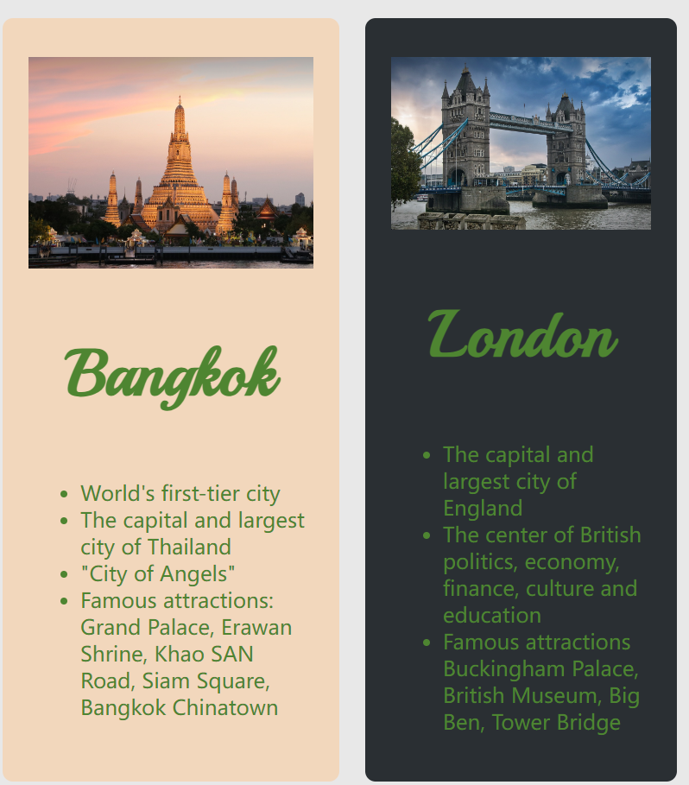
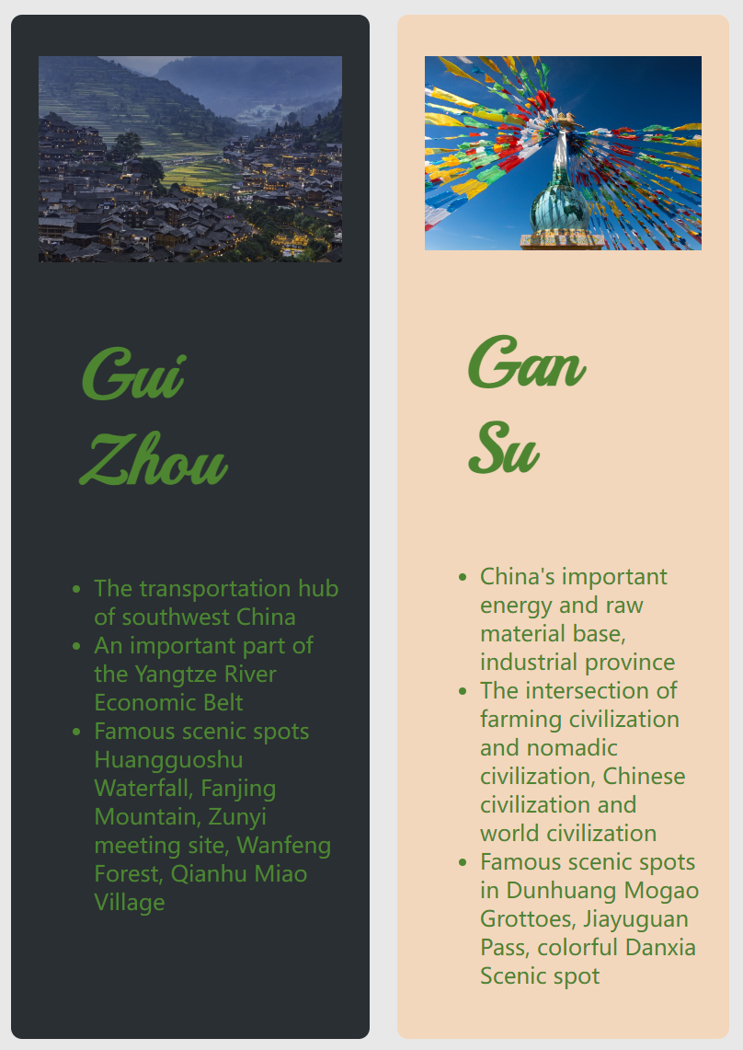
Function Display
Recommended page
Search function: Click Select for the city and schedule you have identified, and relevant text will be pushed to you, introducing local customs and recommended travel guides.
Advertisement: Recommend templates that include attractions, customs, cuisine, and accommodations from various cities, providing users with reference.
List
Here are examples of popular attractions and popular travel destinations. If users are interested, they can choose their desired destinations and click to learn more.

Slide 17

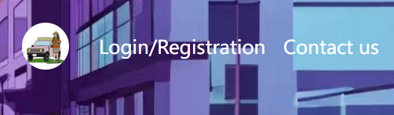
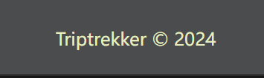
Function Display
Supplementary
Introduction
Travel
Each page contains a logo, account, and footer. The logo is a design that combines vehicles and scenery, highlighting the theme function of the webpage - carpooling, and the color tone is also consistent with the overall webpage. The account consists of an avatar and a username, which need to be displayed after logging in. The footer includes the website name and creation date.
100%

Slide 18
04
Collaboration
Summary

Slide 19
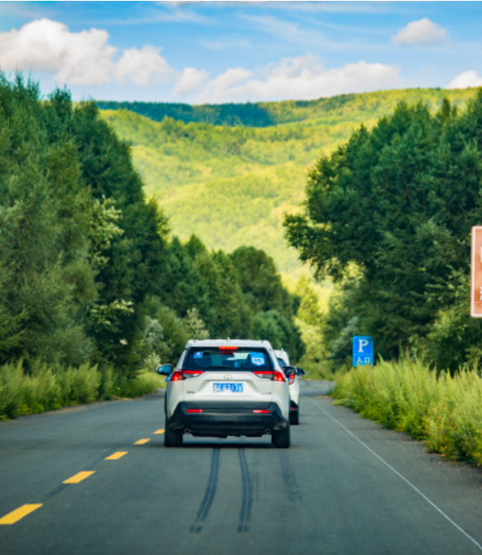
Collaboration Summary
Conclusion
Travel
Web page construction lacks real interaction and only builds three basic visual frameworks.The group members divided the tasks of typesetting, design, images, and copy, and completed the writing of. html and. css files.

Slide 20




Collaboration Summary
Tian Chenmeng
Fei Mingyue
Wang Jia
Qi Danyu
Design webpage layout, coordinate planning, supervise and correct.
Web text editing, video recording and explanation, Collect and analyze competitors.
Collect relevant images, study color design, and write reports,Integrate data.
Design and build a PPT, collect relevant comparison websites and organize them.
fearlessLeader
DesignGuru
TextMaster
fearlessLeader
DesignGuru
TextMaster
PlxeMeister
DesignGuru

Slide 21

CAMPUS
Thank you for
watching
URL：https://tianmen555.github.io/158.258_A1_G7/

